Slide 1
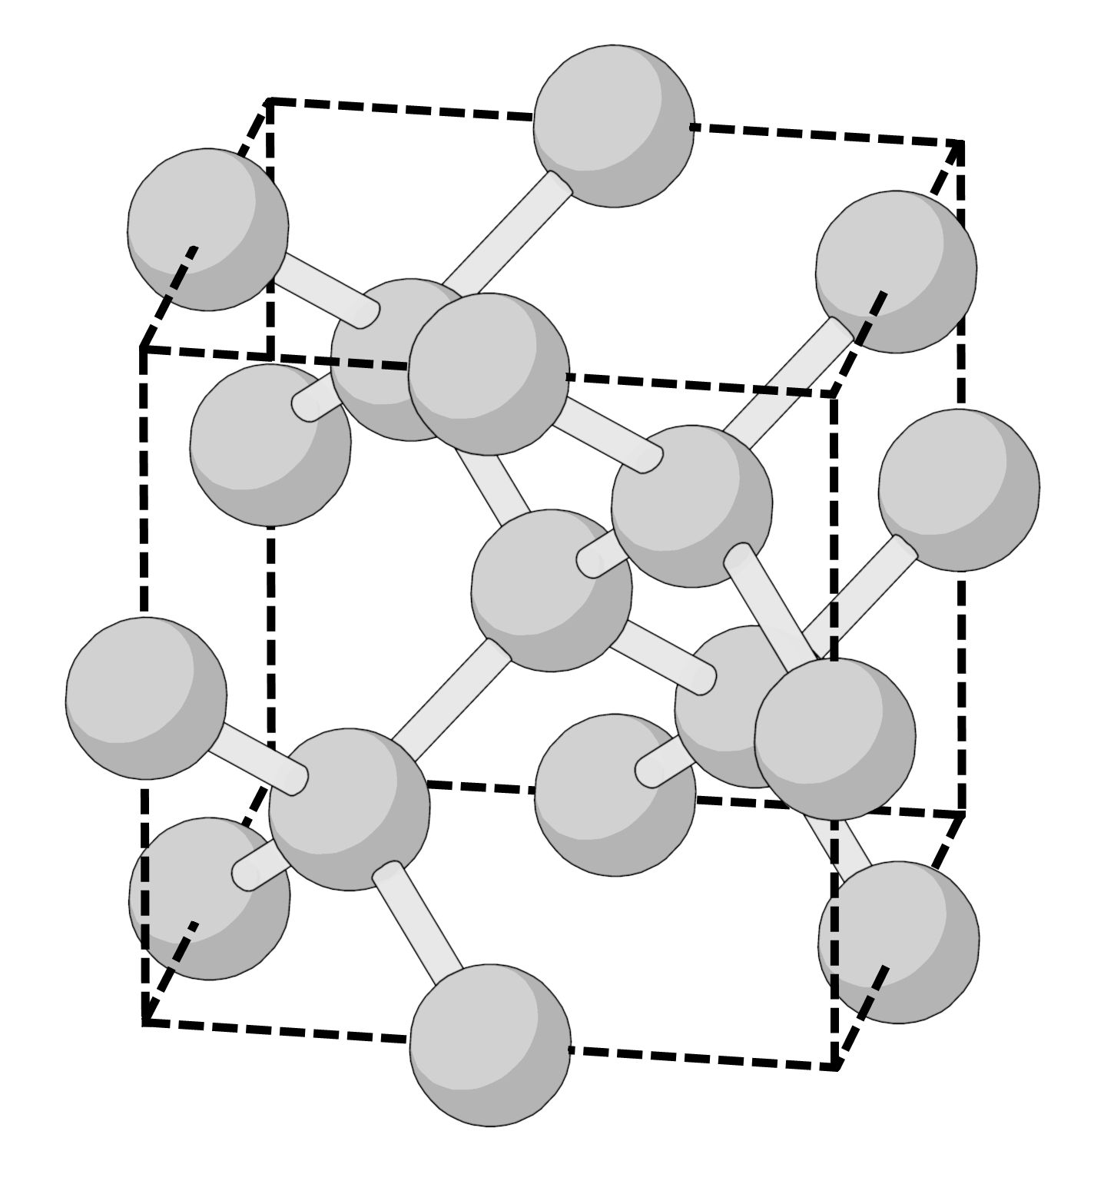
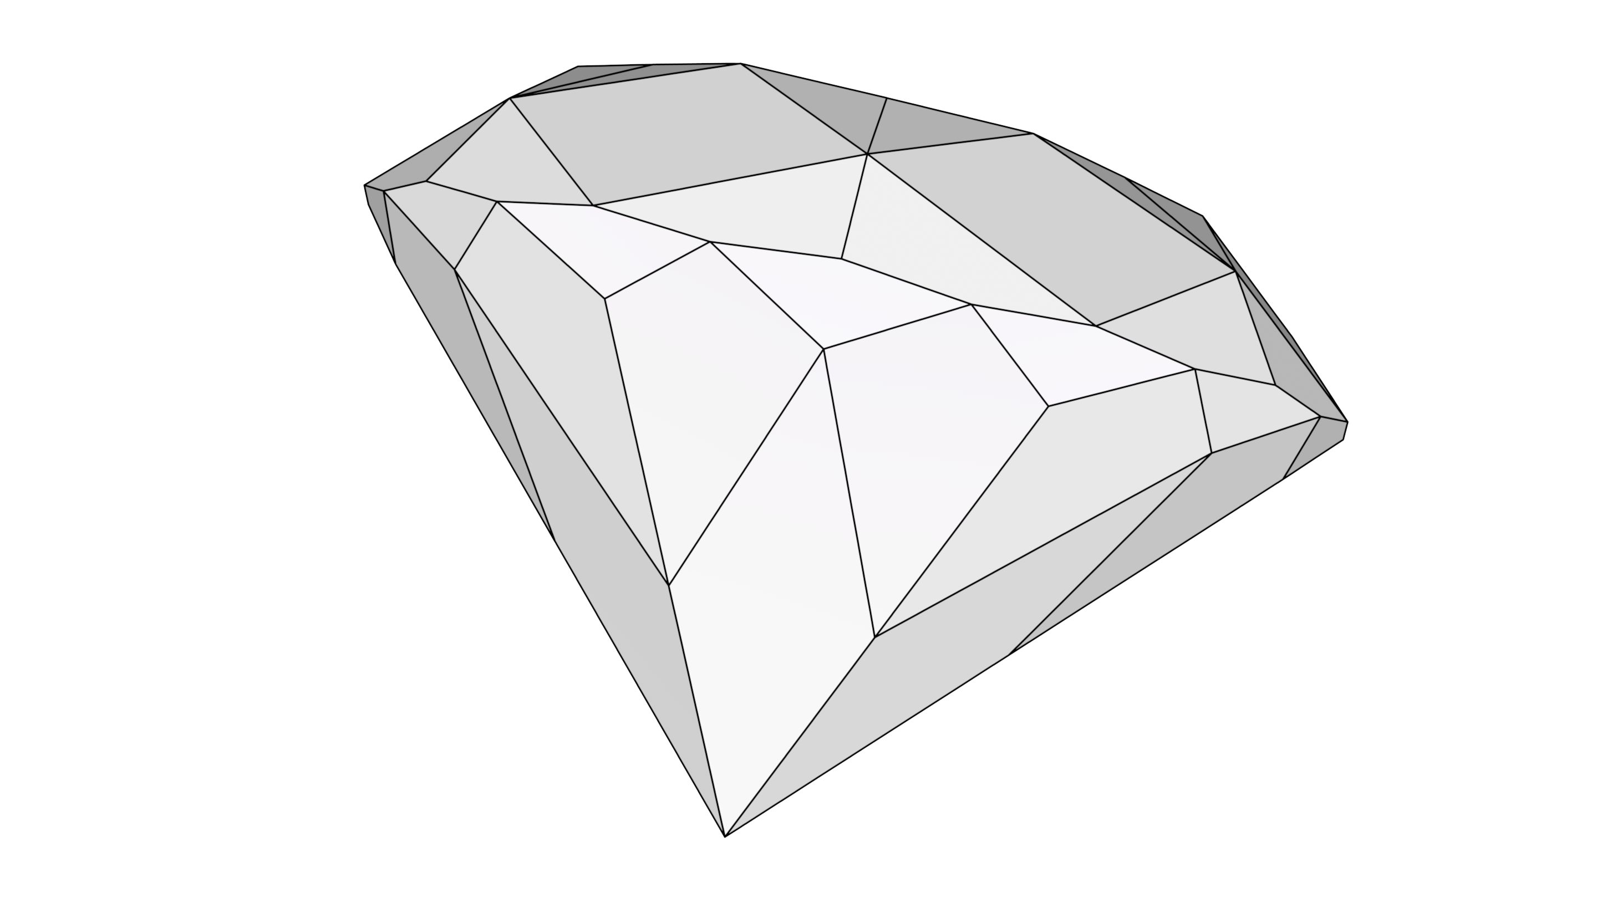
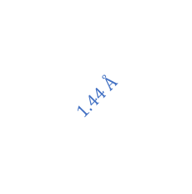

$$a_{0}=3.567 Å$$
$$1.44 Å$$

Slide 2
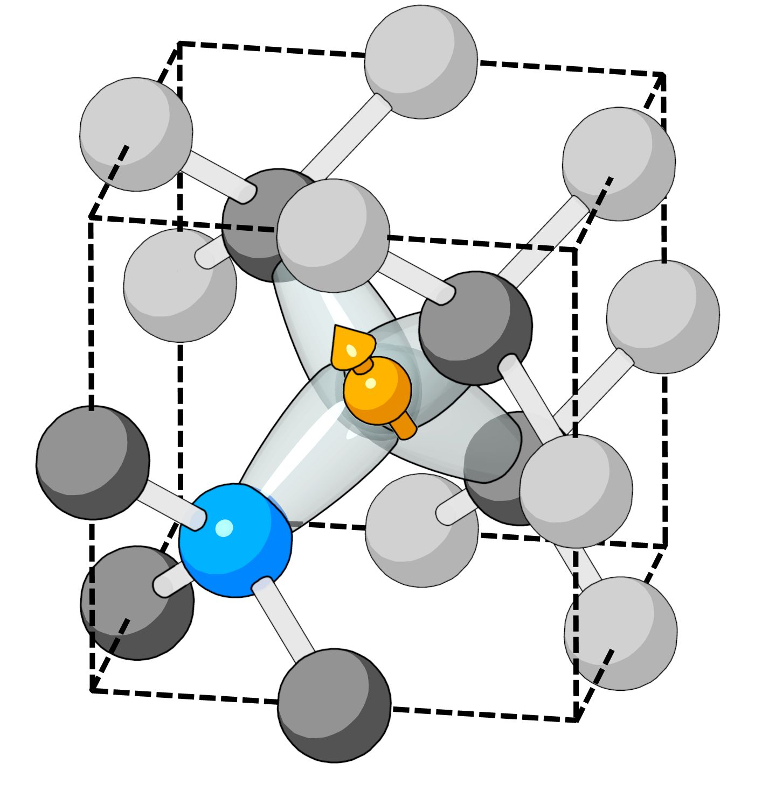
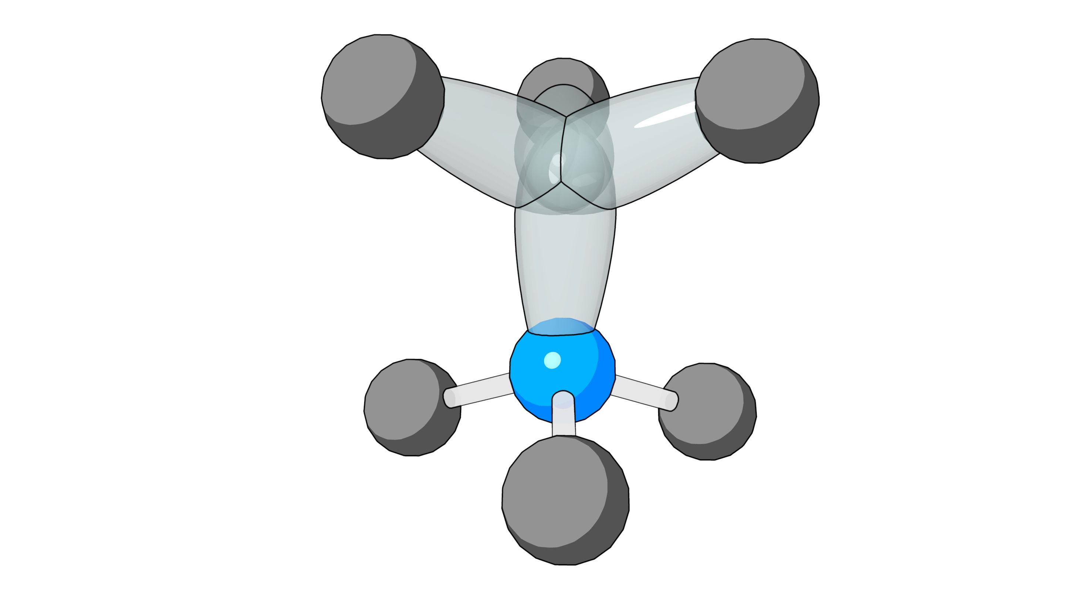
[1 1 1]

Slide 4
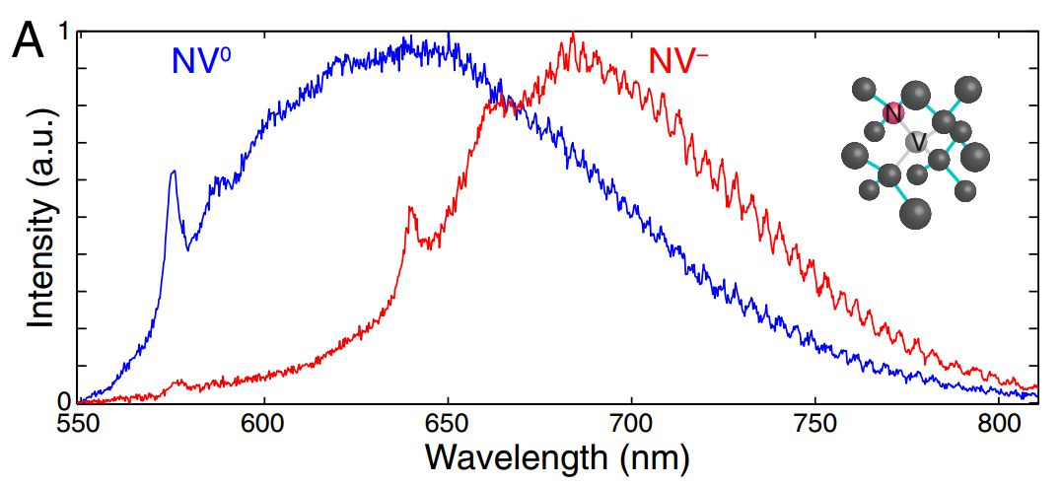
575 nm
637 nm

Slide 5
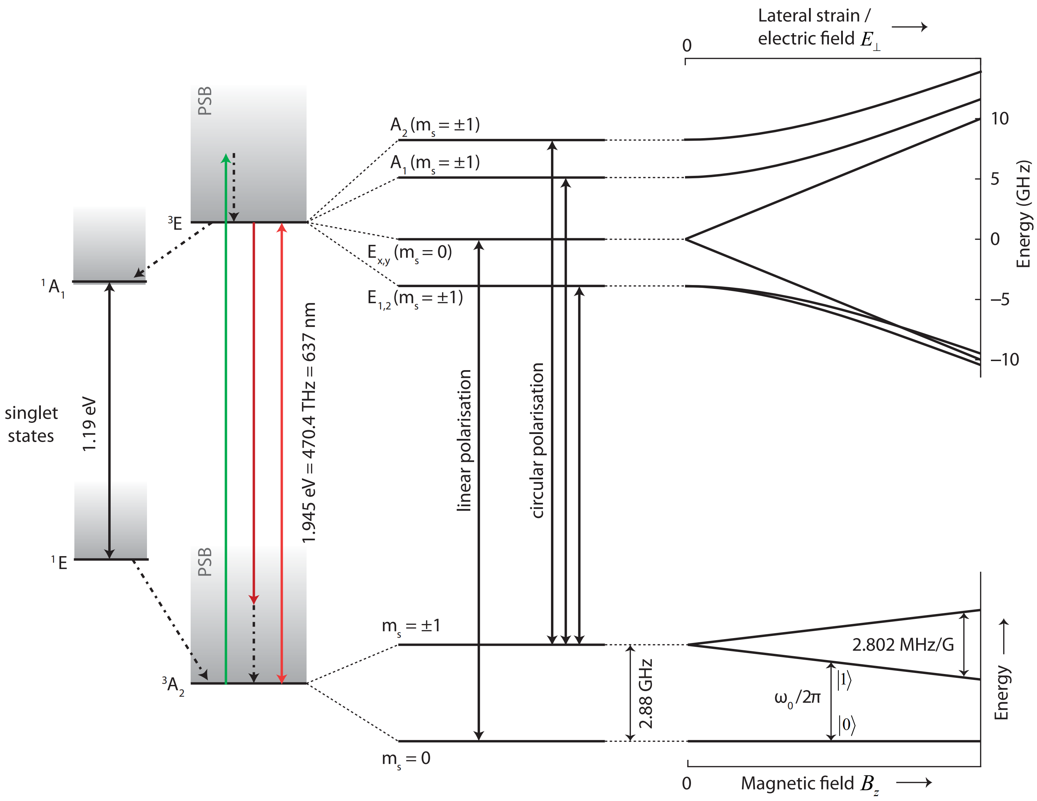
(c)
(a)
(b)
(d)

Slide 6
532 nm laser
irradiation
Initialization/detection
Microwave
manipulation
MW
Photon counting
(650 – 800 nm)
Read out

Slide 7
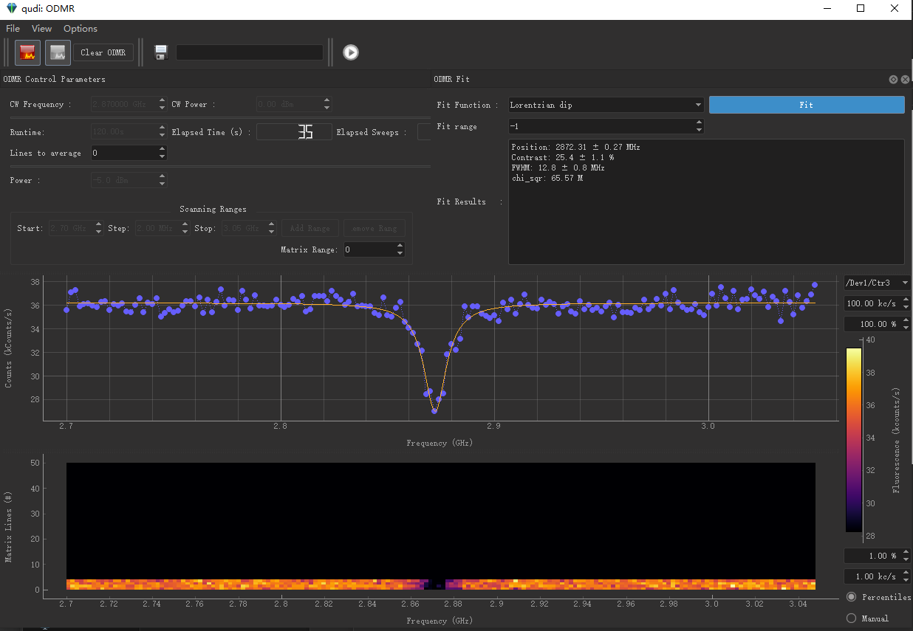
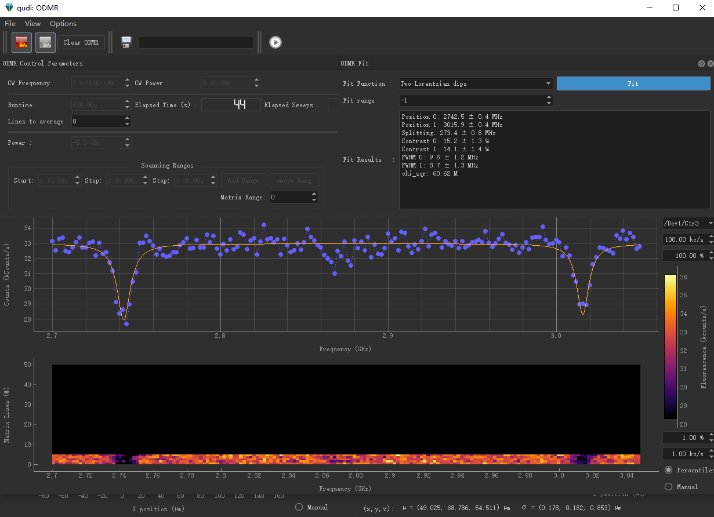
(a)
(b)

Slide 8
532 nm laser
irradiation
Initialization
Detection
Microwave
manipulation
Pulsed sequence
Photon counting
(650 – 800 nm)
mes
ref

Slide 9
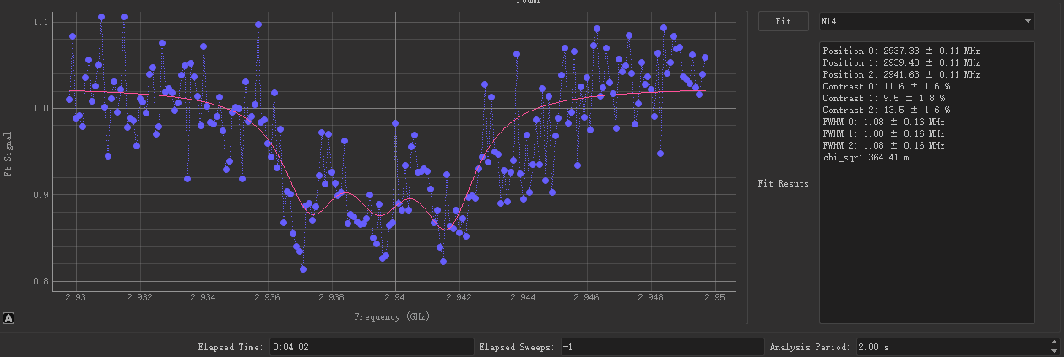
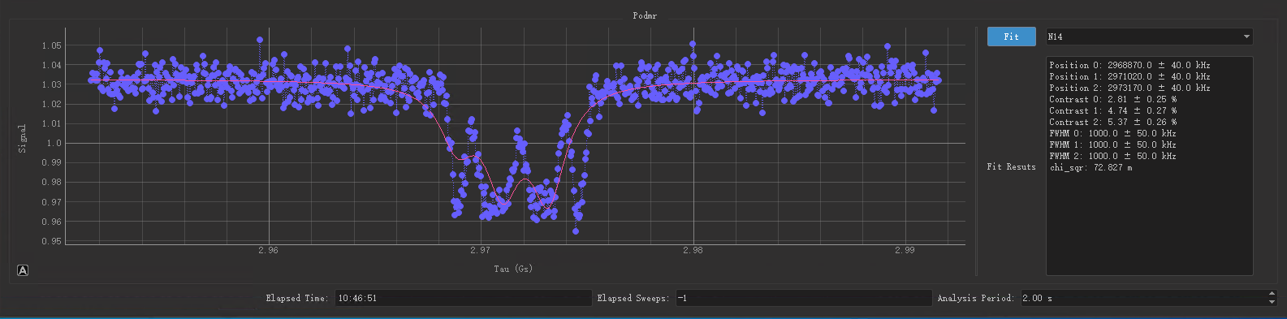
(a)
(b)

Slide 10
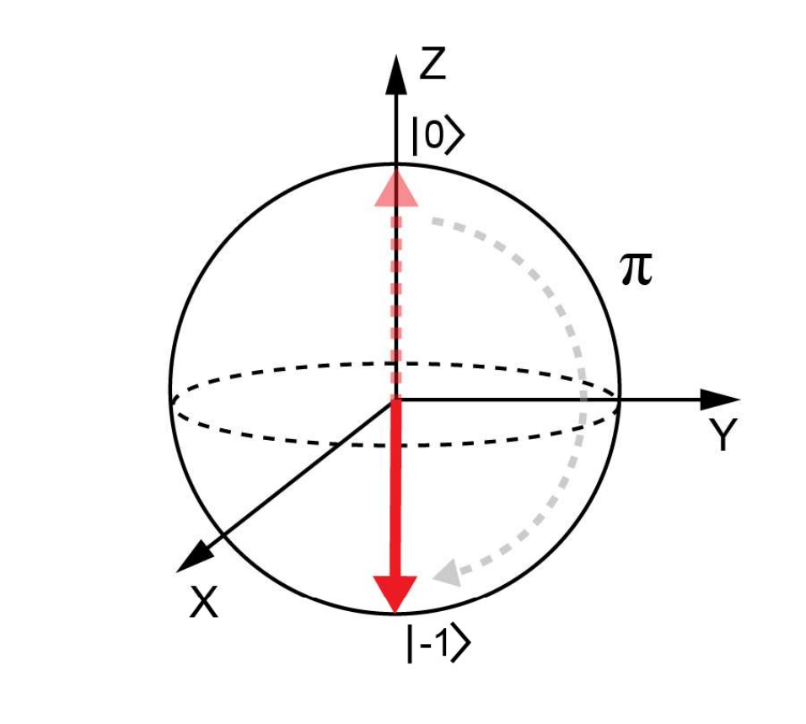
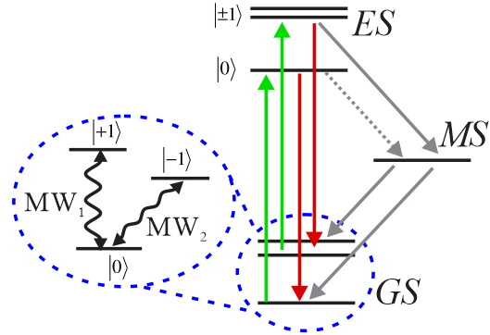
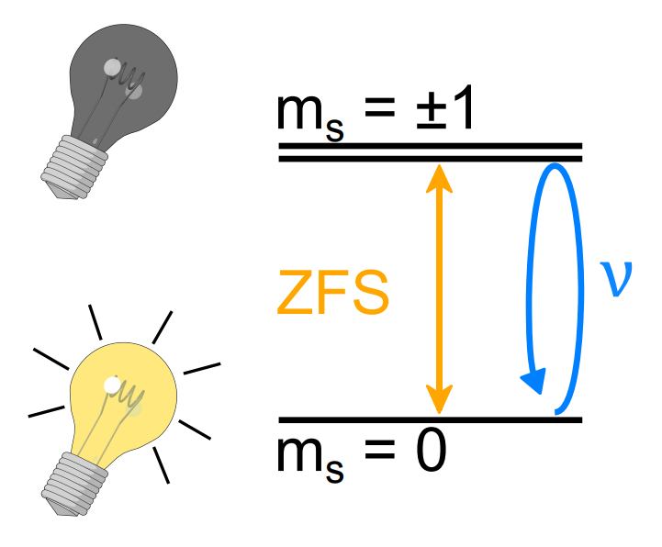
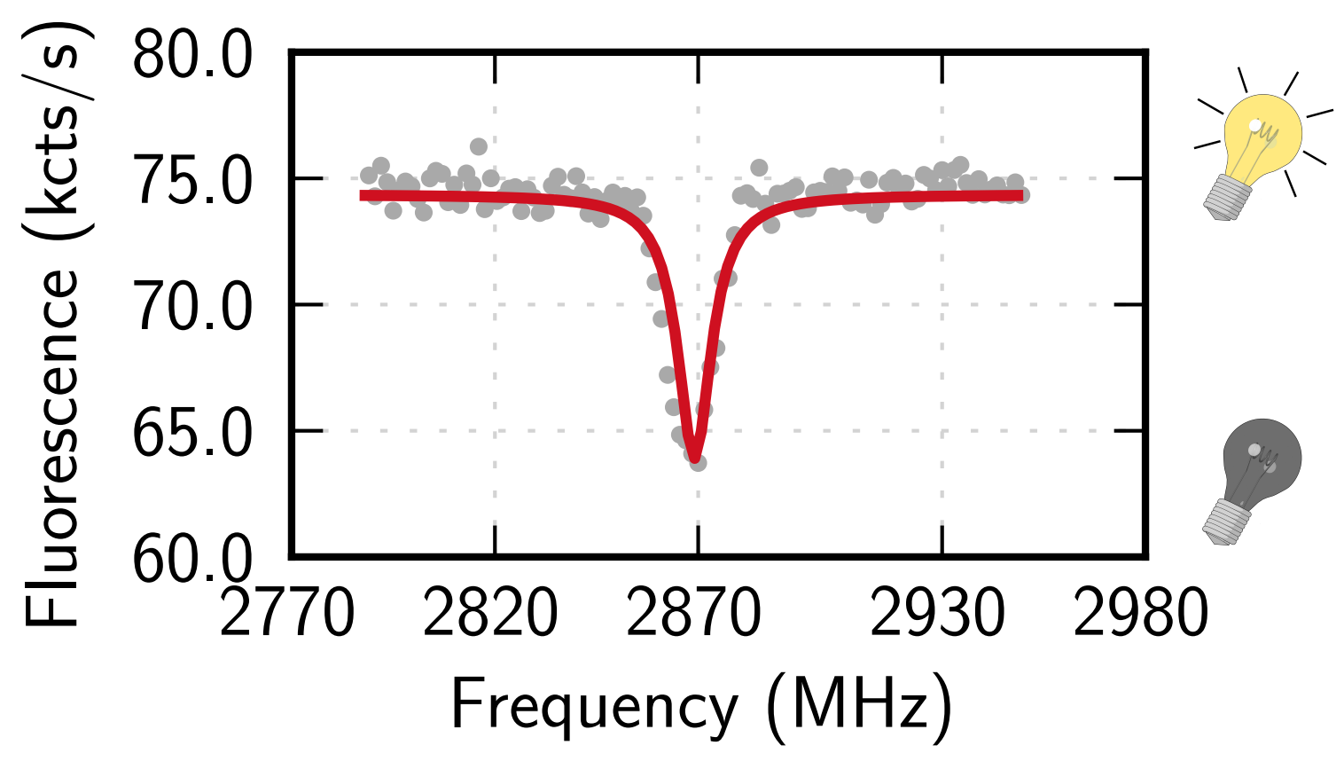
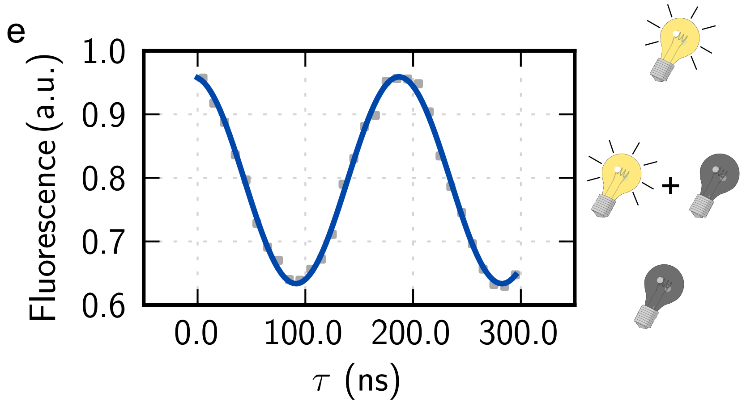
(a)
(b)
(c)
(d)
(e)

Slide 11
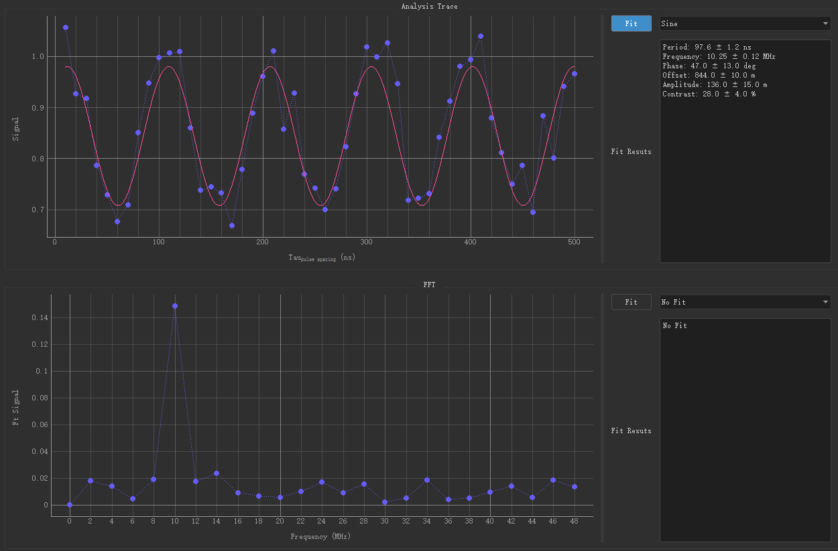
(a)
(b)

Slide 12
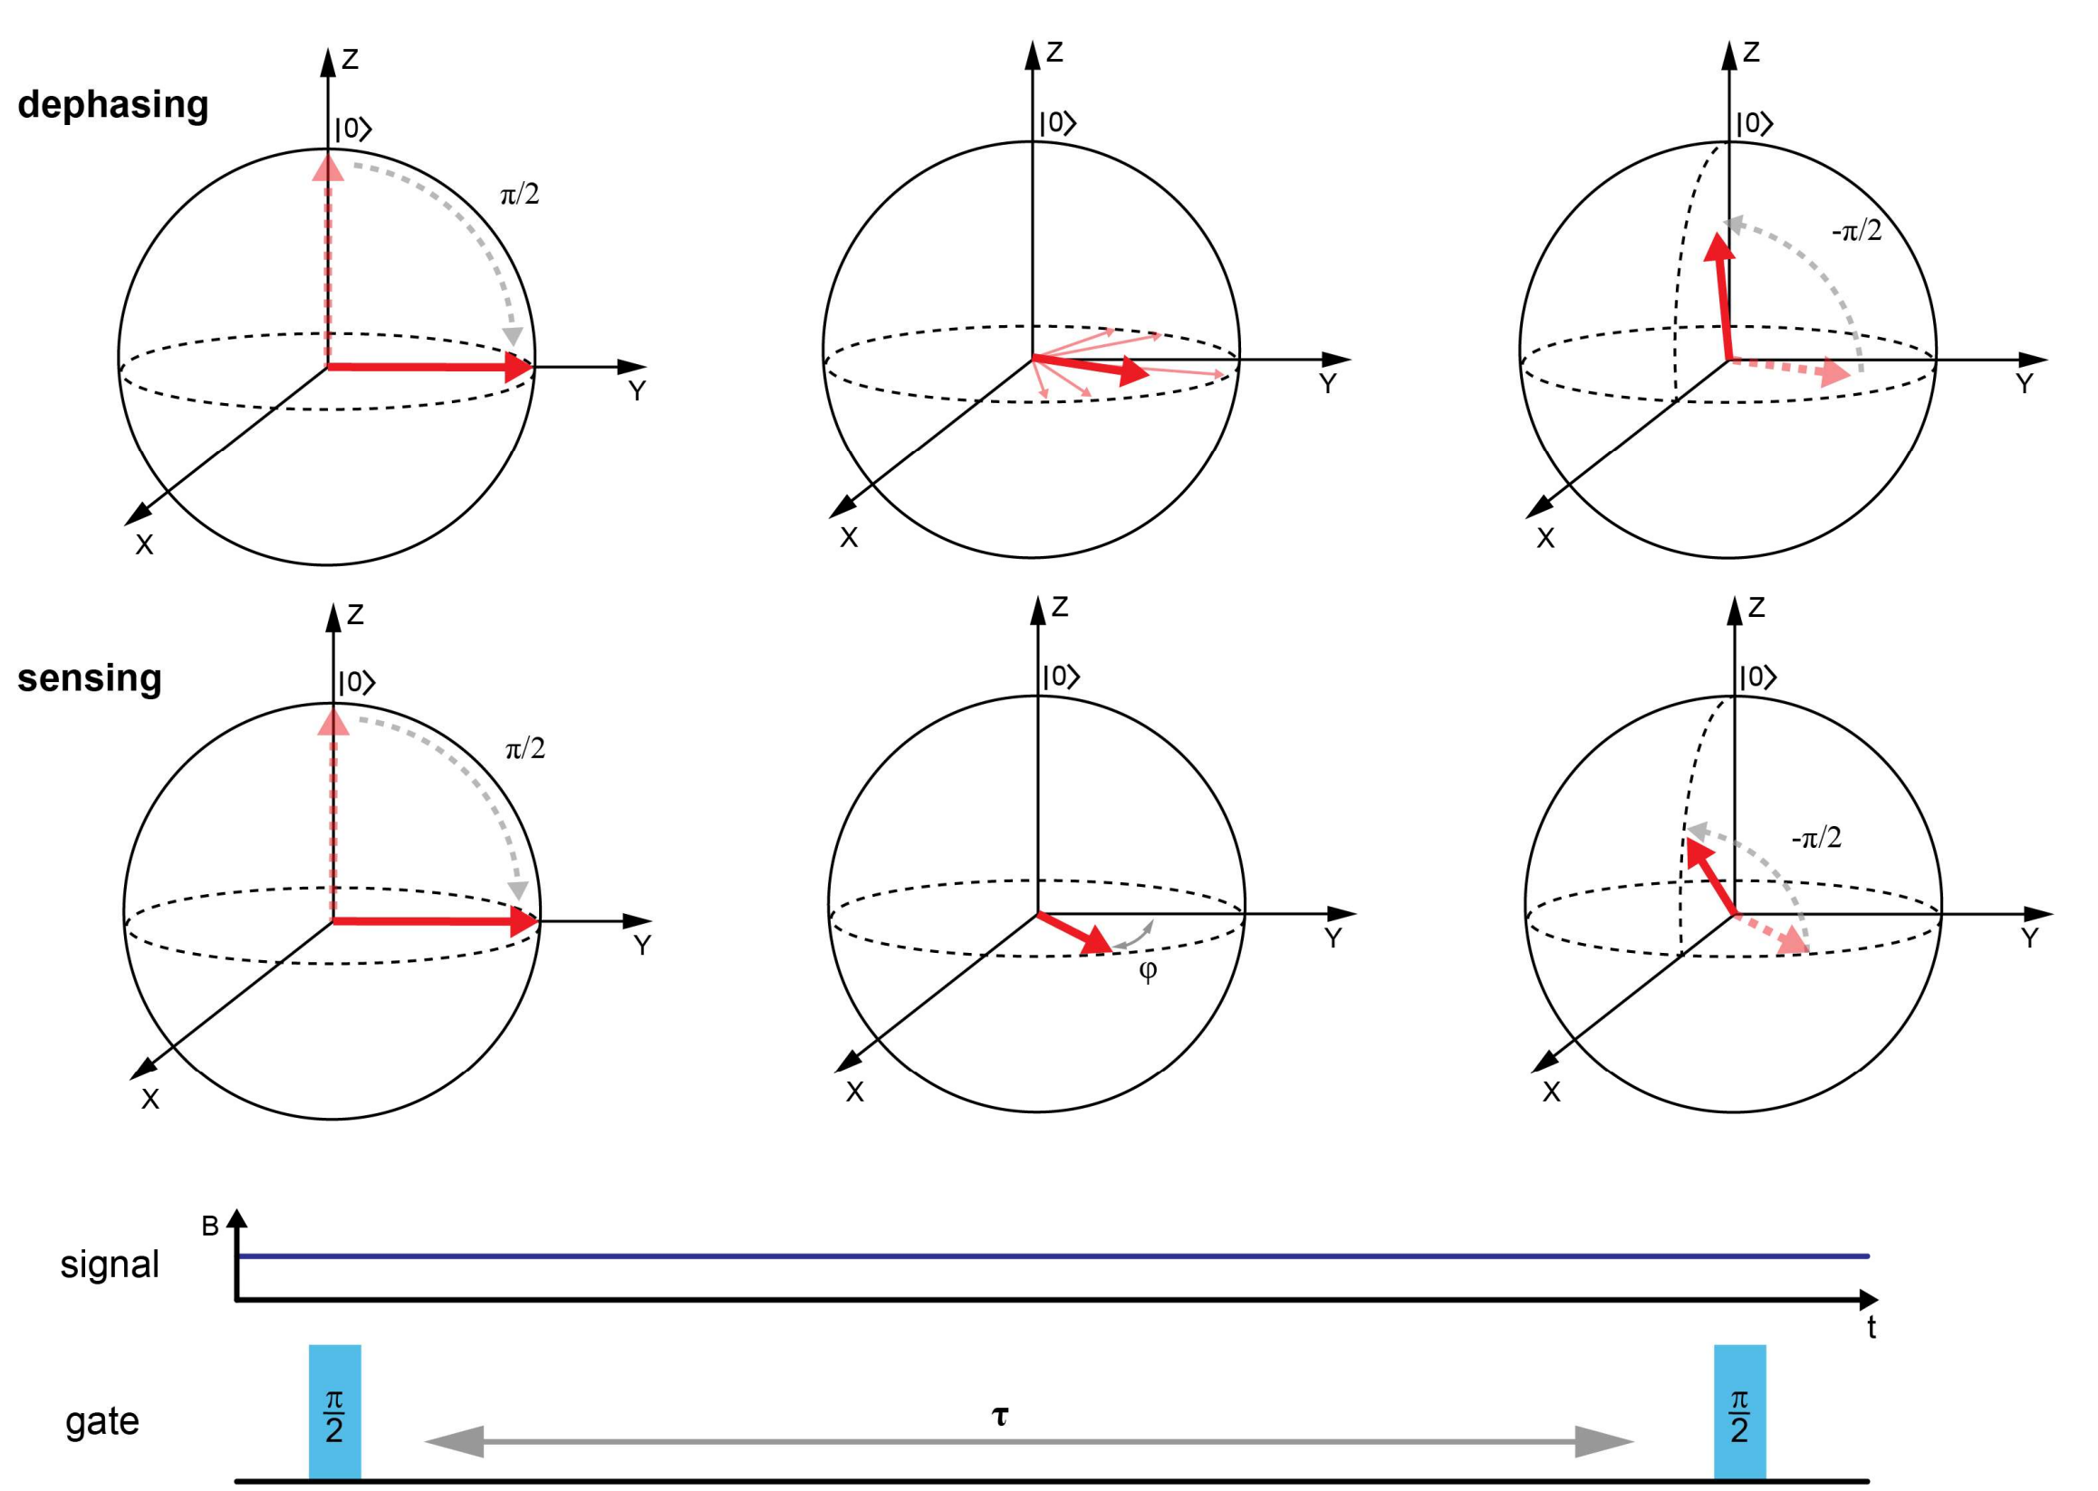
(a)
(b)

Slide 13
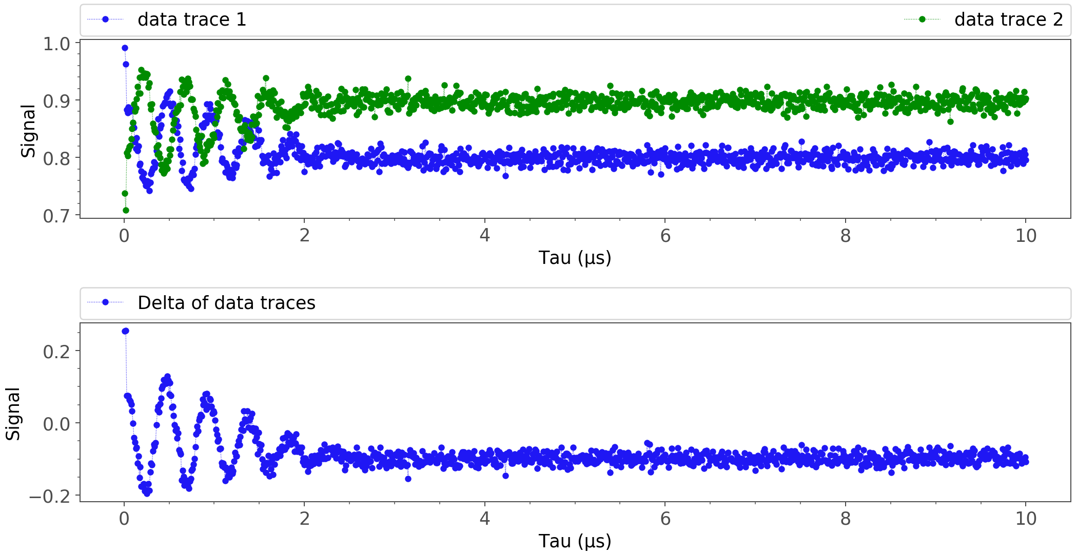
(a)
(b)

Slide 14
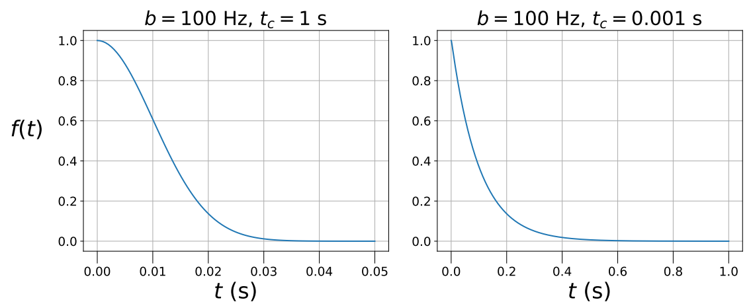
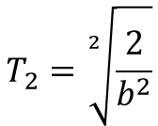
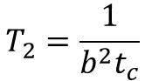
(a)
(b)
b >> 1/t_{c}, t << t_{c}
b << 1/t_{c}, t >> t_{c}
$$T_{2}=\sqrt[2]{\frac{2}{b^{2}}}$$
$$T_{2}=\frac{1}{b^{2}t_{c}}$$

Slide 15
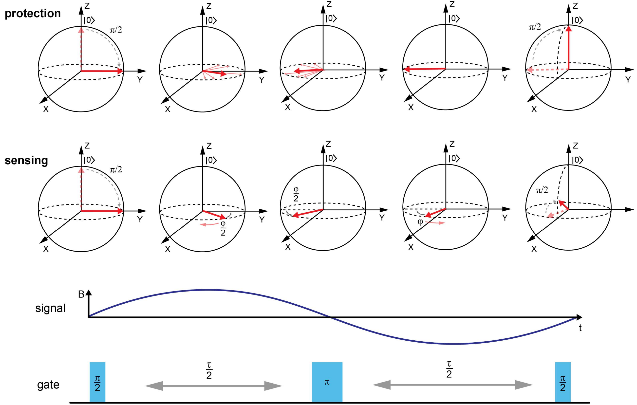
(a)
(b)

Slide 16
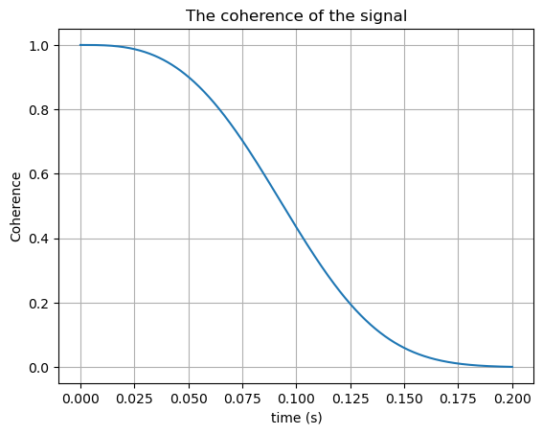
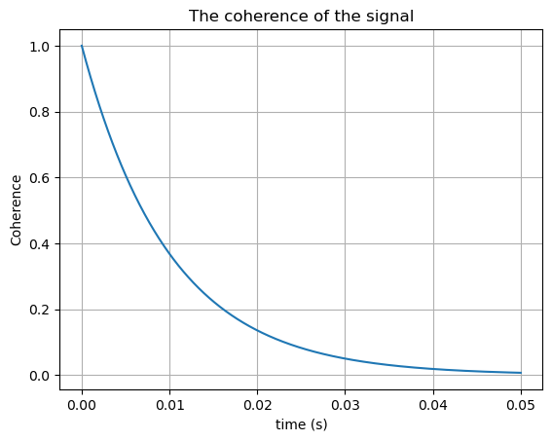
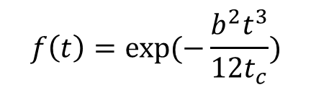
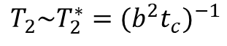
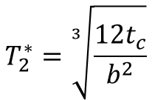
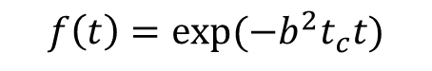
Hahn Echo Decay Shapes
(a)
(b)
t << t_{c}
t >> t_{c}
$$f\left(t\right)=exp⁡(−\frac{b^{2}t^{3}}{{12t}_{c}})$$
$$f\left(t\right)=exp⁡(−{b^{2}t}_{c}t)$$
$$T_{2}^{∗}=\sqrt[3]{\frac{{12t}_{c}}{b^{2}}}$$
$$T_{2}\sim T_{2}^{∗}={(b^{2}t_{c})}^{−1}$$

Slide 17
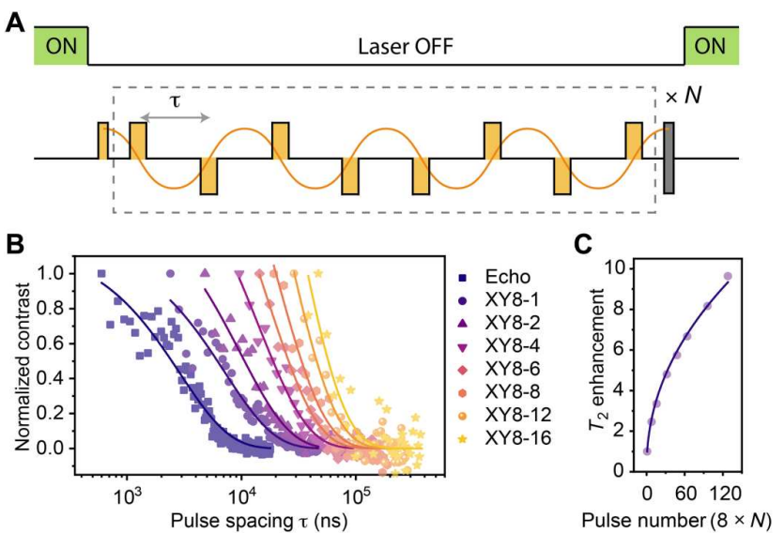
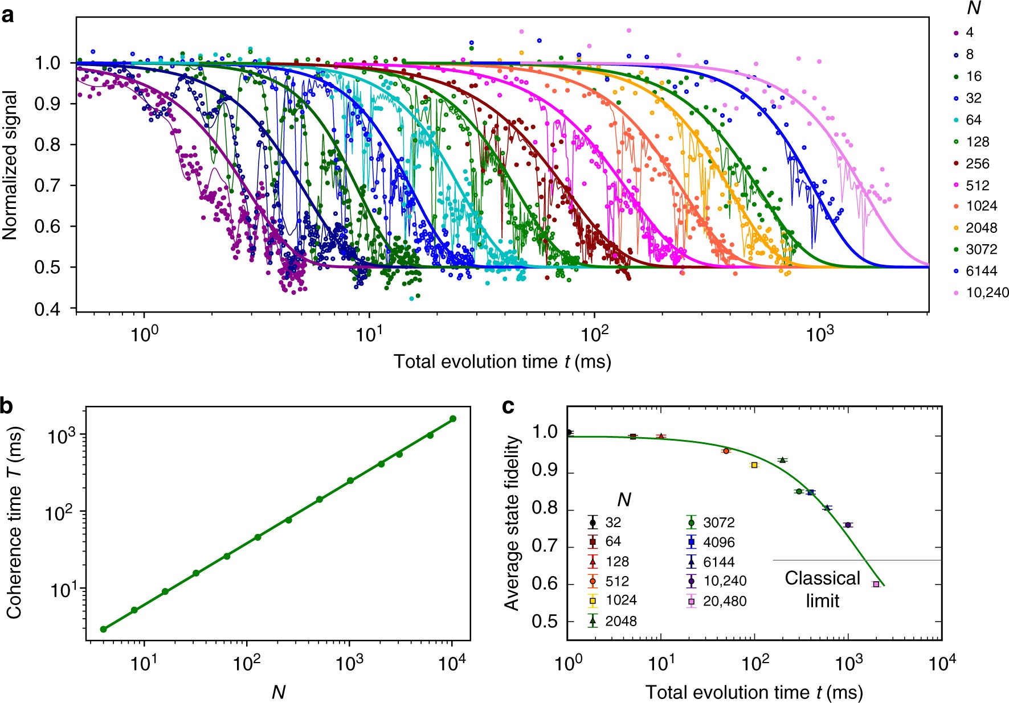
(a)
π_{x}
π_{x}
π_{y}
π_{y}
(b)
(c)
(d)

Slide 18
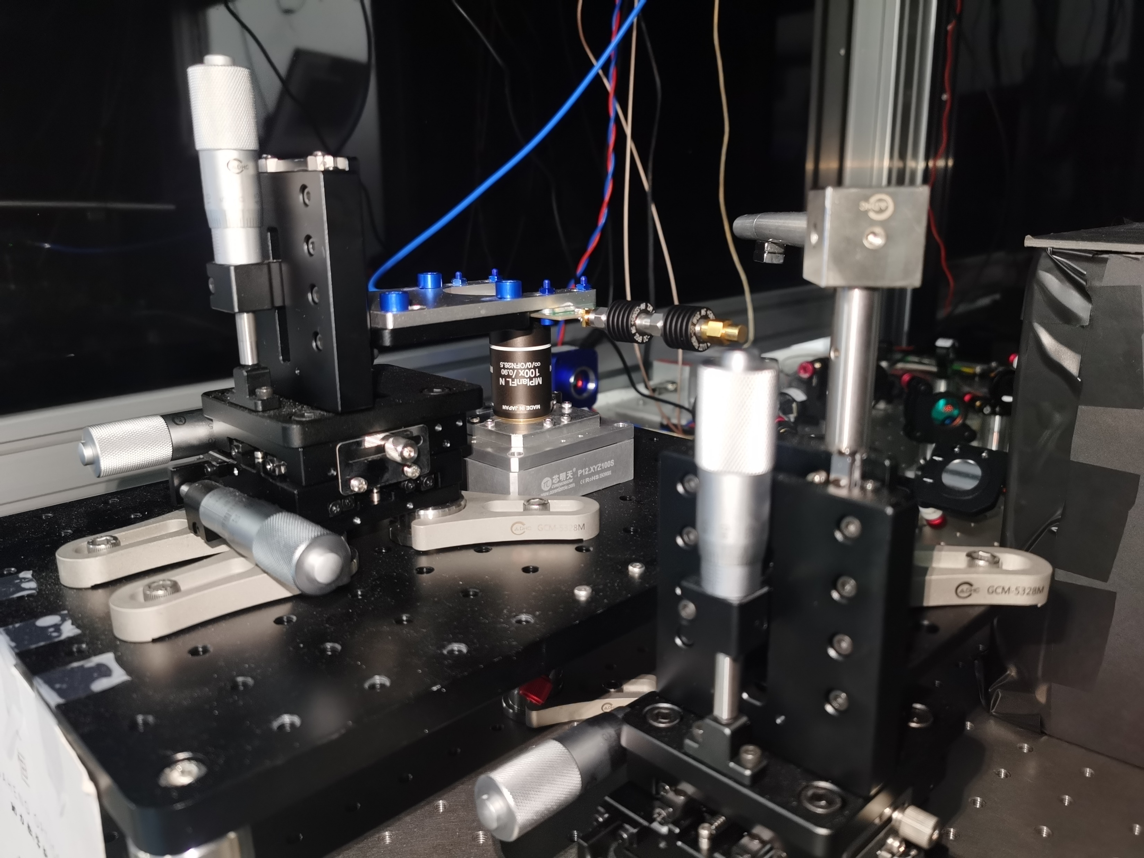
MW Coaxial Cable
Magnet
Sample
Objective
Piezo XYZ Stage
Manual XYZ Stage

Slide 19


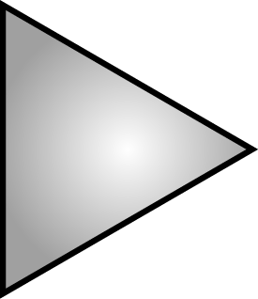
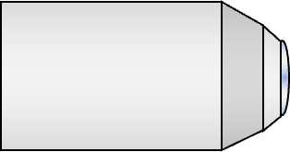
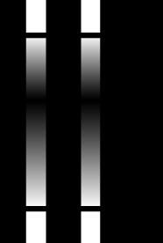
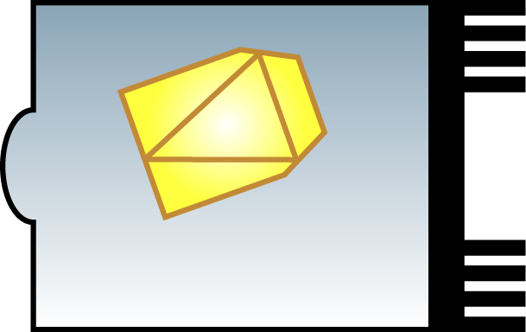
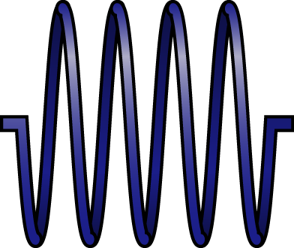









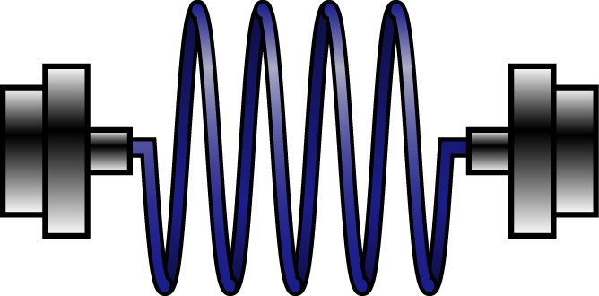
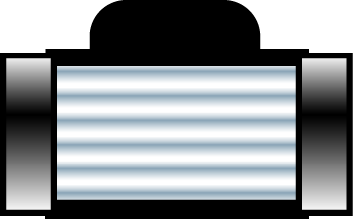
AWG
Mixer
Sample
MW Source
Objective
MW Amplifier
Piezo XYZ Stage
600 nm LP DM
APD
663-800 nm
BP Filter
Computer
550 nm LP DM
NPBS (9:1)
PD 1
PD 0
594 nm Laser
Spatial AOM
Fiber
Fiber AOM
532 nm Laser
Mirrors

Slide 20
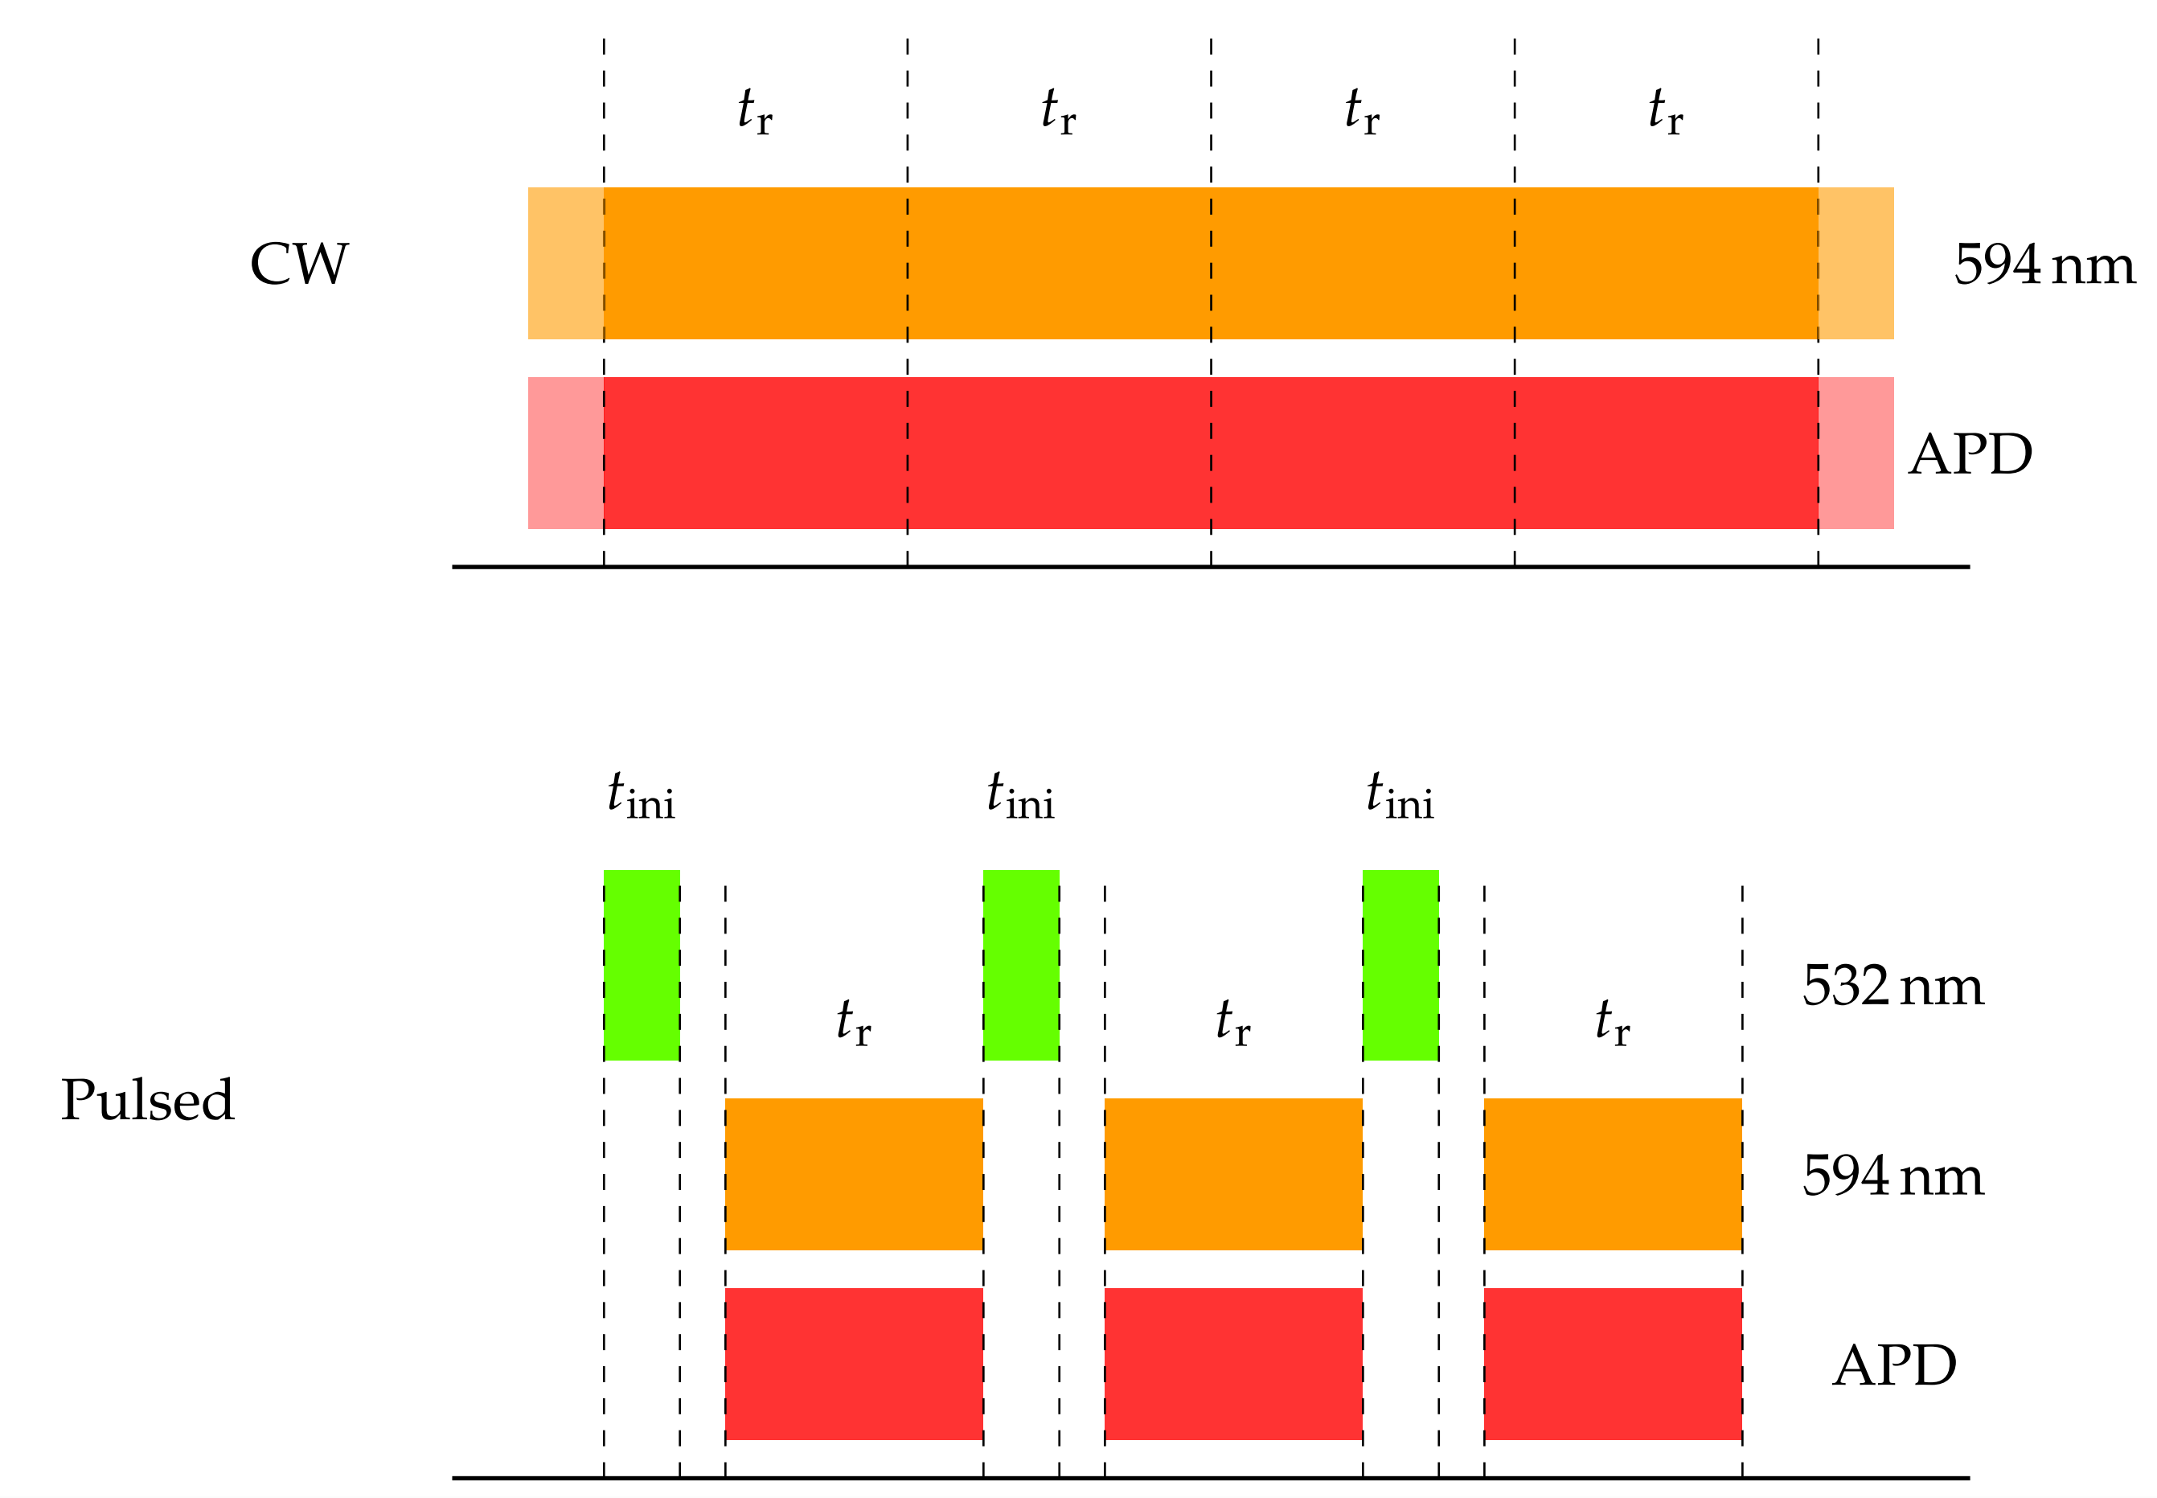
(a)
CW
(b)
Pulsed

Slide 21
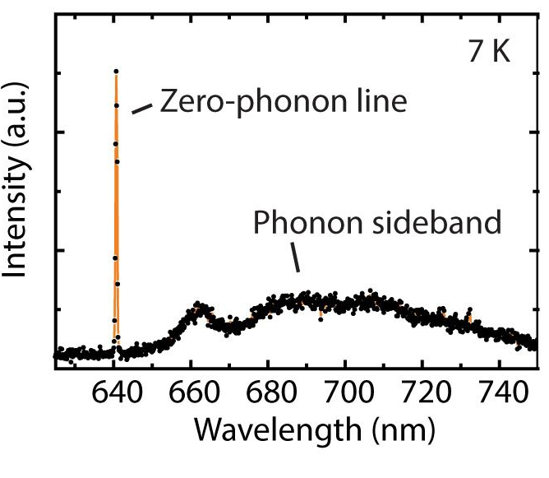
(a)
(b)
E
B
SR
S
C
m=0
E_{excited}
Absorption
Emission
ZPL
D
ZPL
SR
AS
A
n=0
E_{ground}
ZPE
q_{ground}
q_{excited}
q

Slide 22
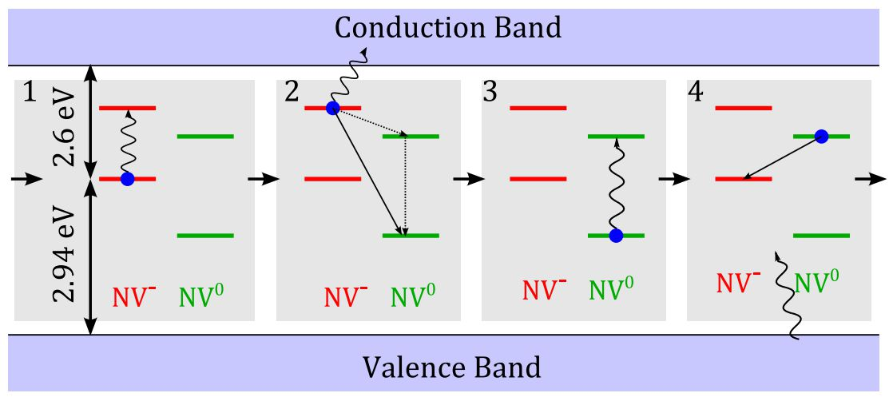
(a)
(b)
(c)
(d)

Slide 23
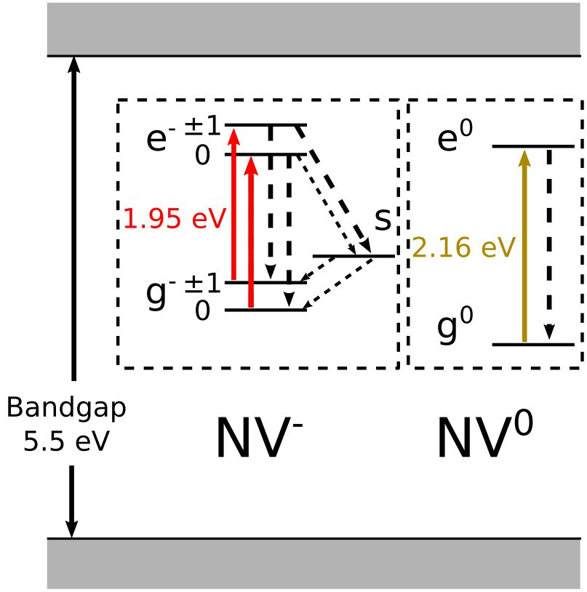
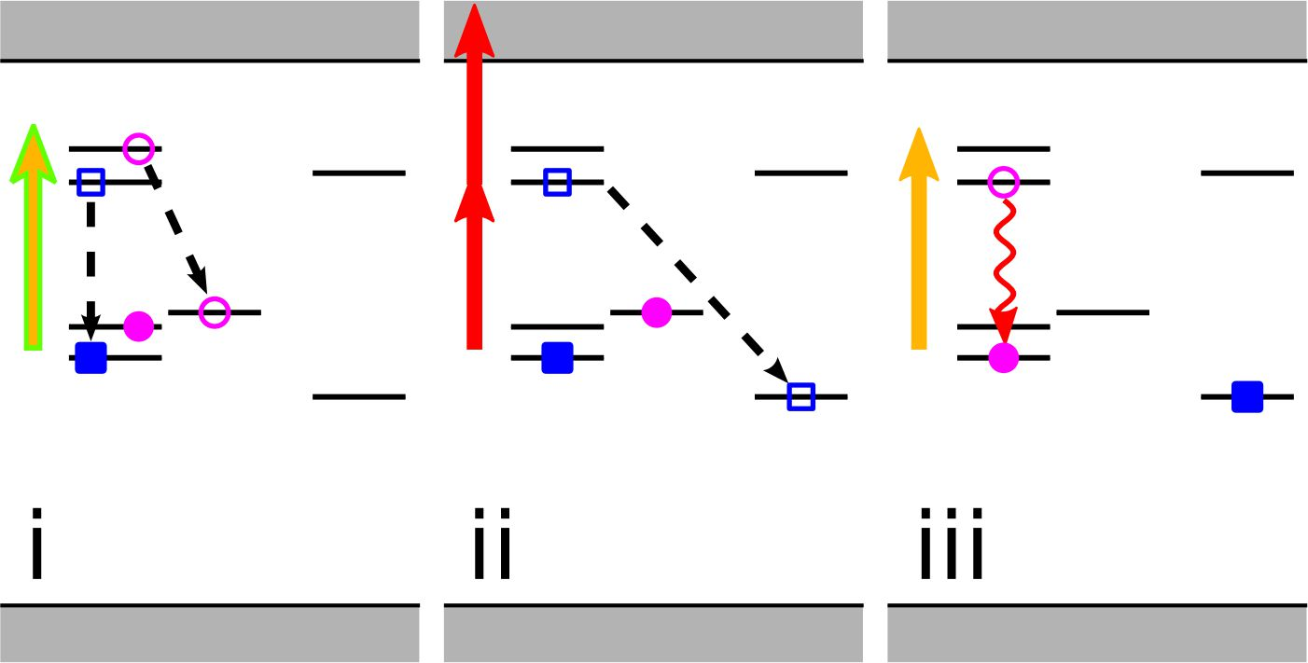
(a)
(b)
(c)
(d)

Slide 24
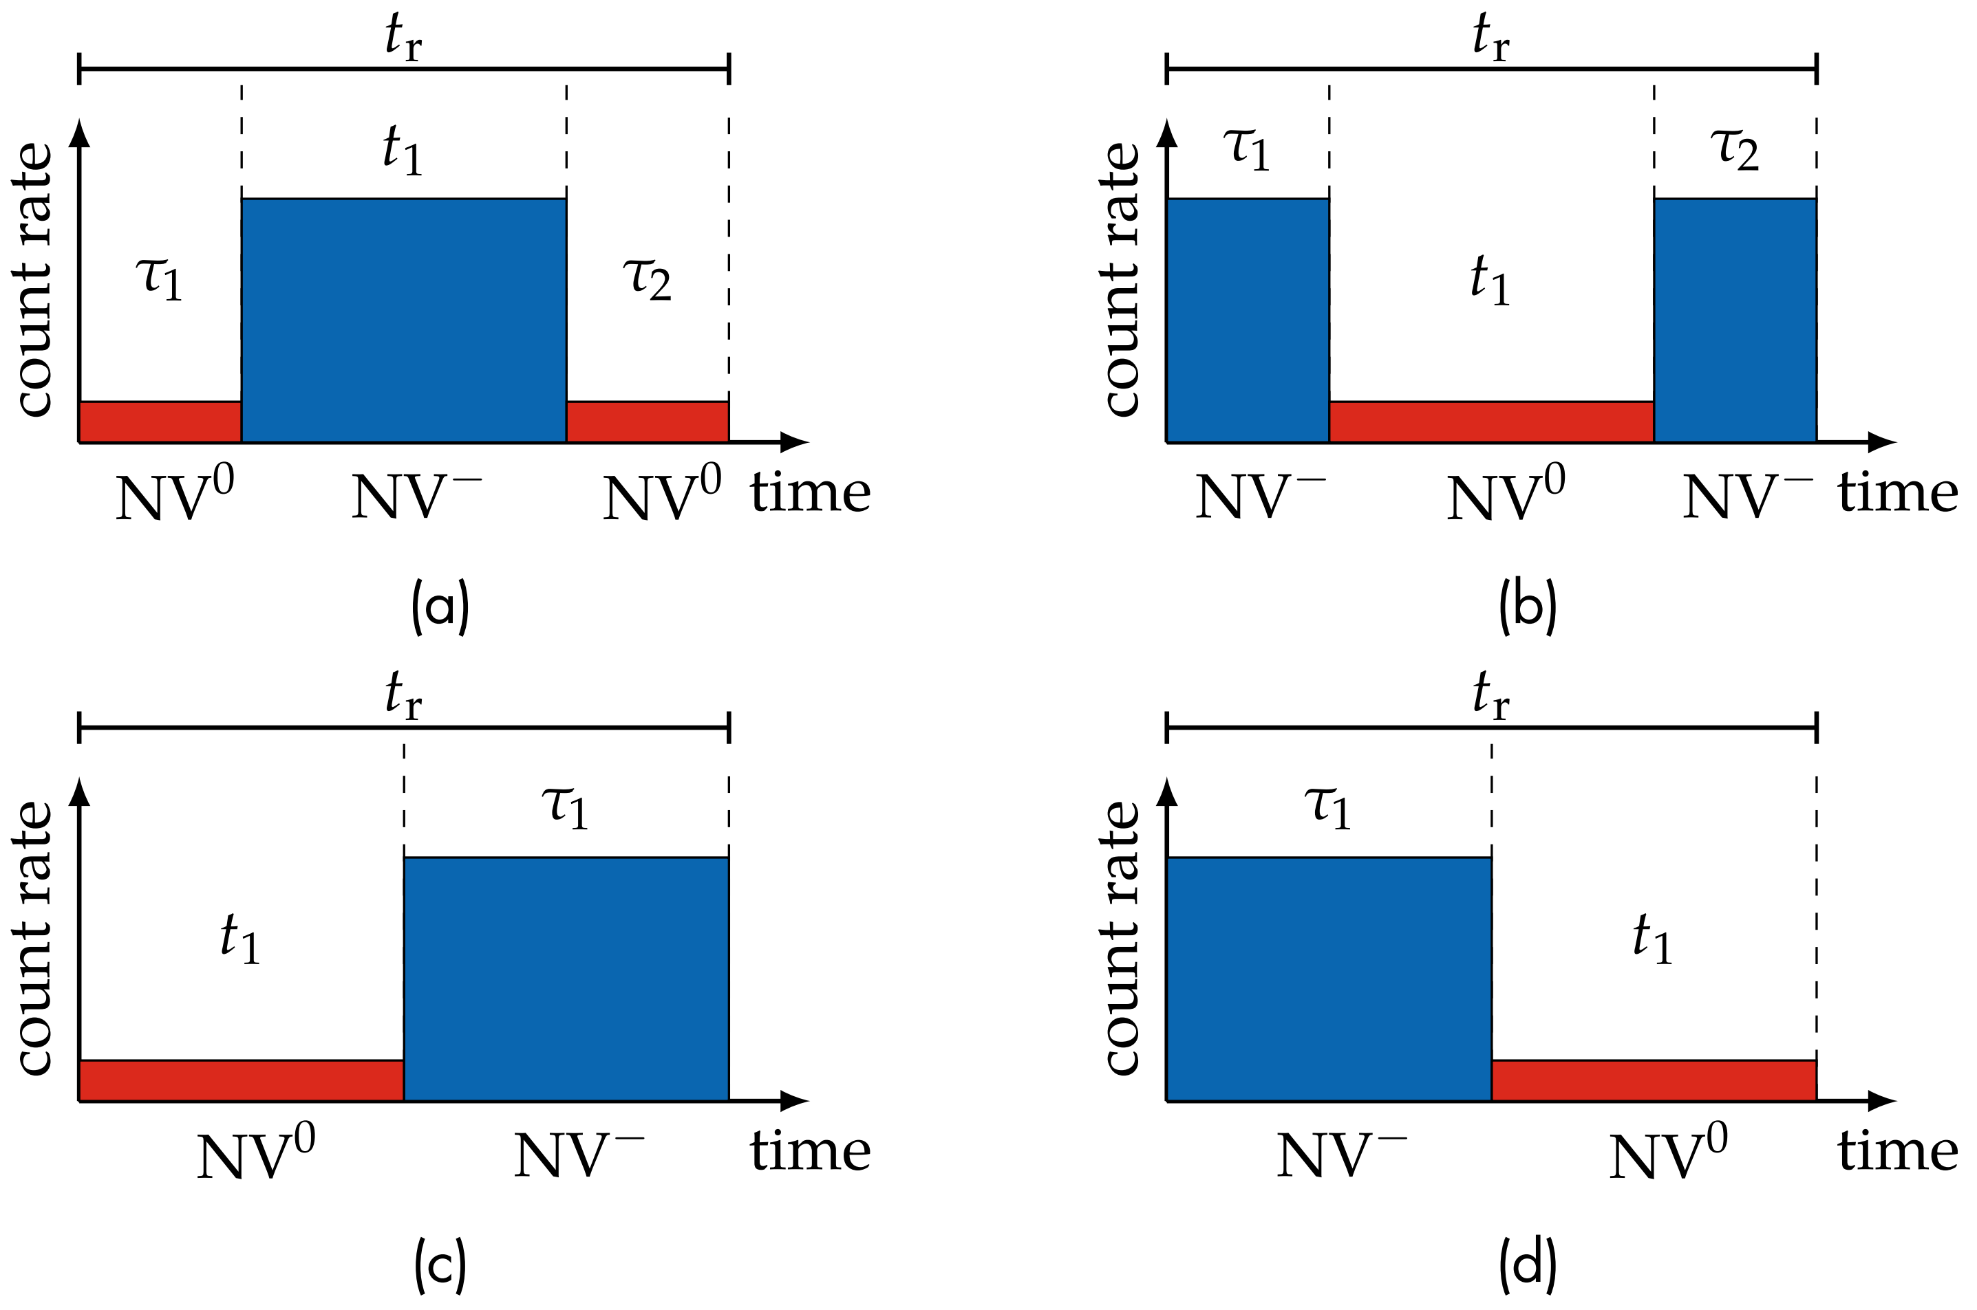

Slide 25
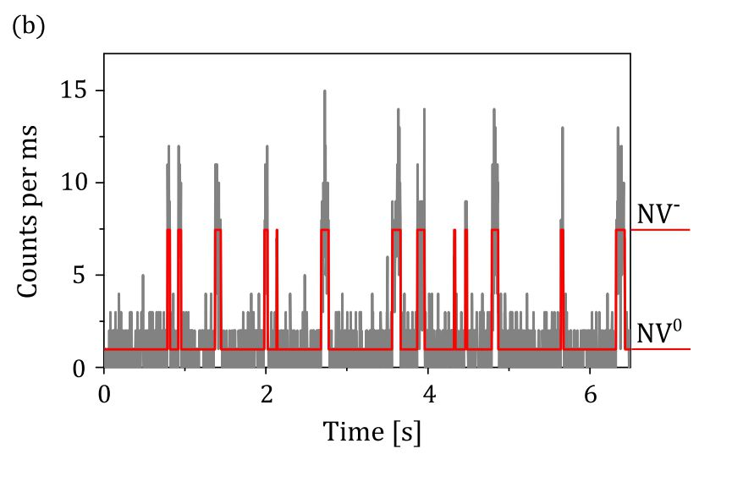
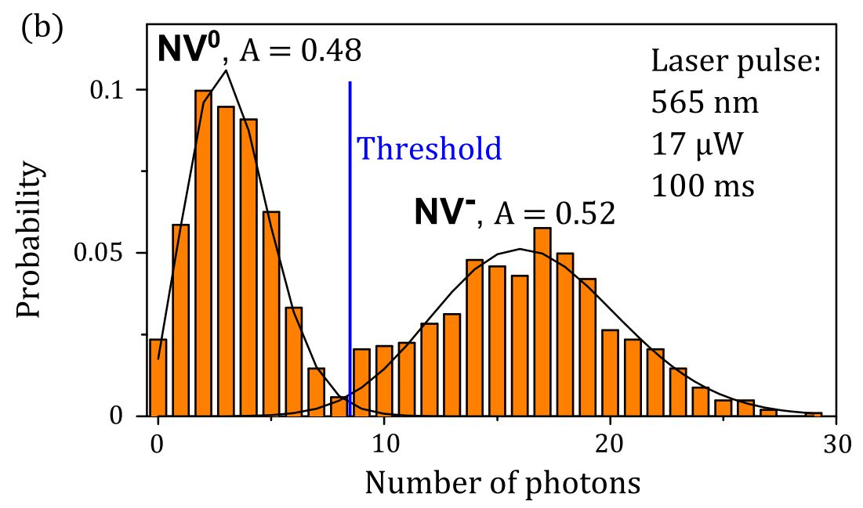
(a)
(b)

Slide 26
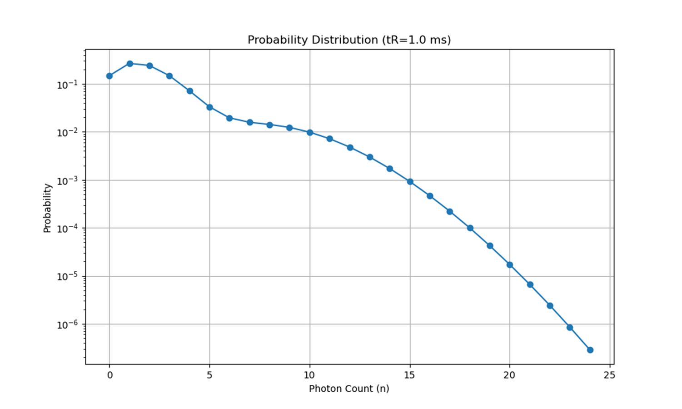
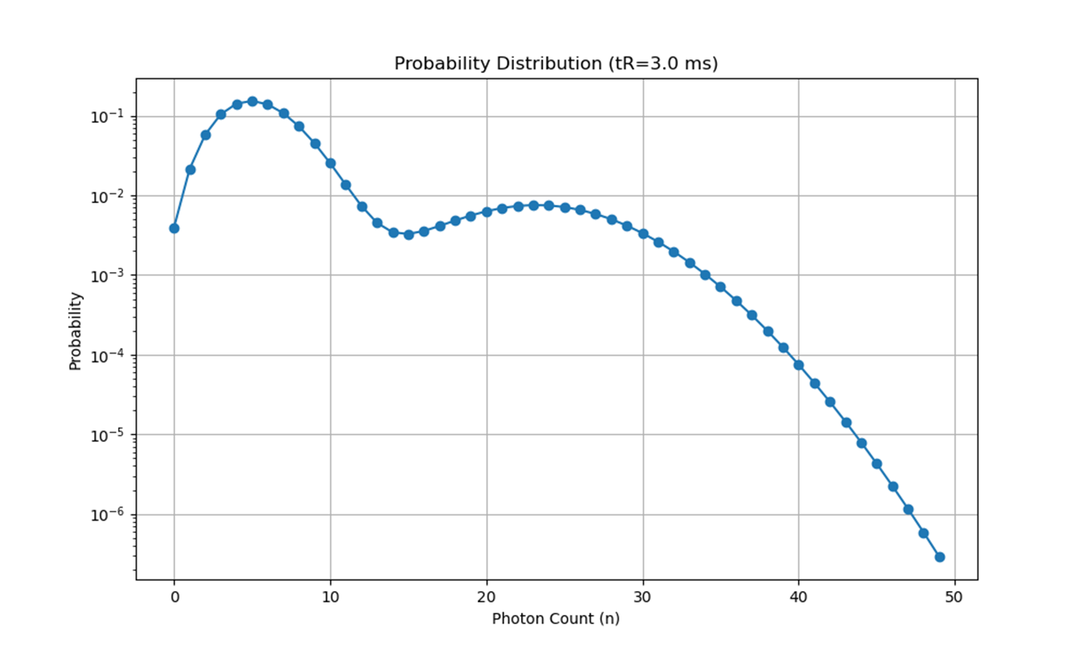
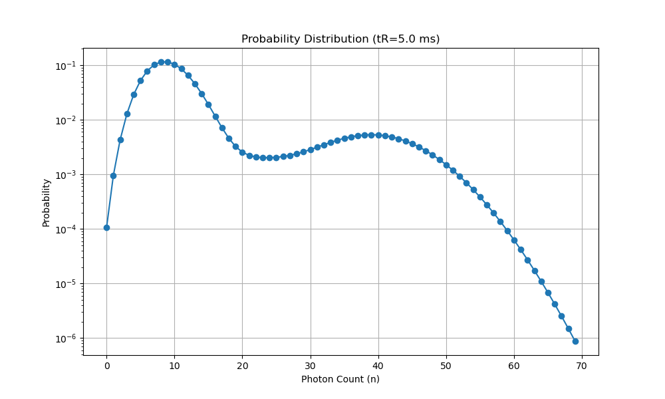



(a)
(b)
(c)
(d)
(e)
(f)

Slide 27


Slide 28




(a)
(b)
(c)
(d)

Slide 29


(a)
(b)

Slide 30


(a)
(b)

Slide 31








(a)
(b)
(c)
(d)
(e)
(f)
(g)
(h)

Slide 32



(a)
(b)
(c)
(d)

Slide 33




(a)
(b)
(c)
(d)

Slide 34






(a)
(a)

